Slide 1

Action Recognition with CNN + LSTM
By – Manav Malik
YouTube

Slide 2
Motivation & Objectives
Why action recognition?
Video analysis has many applications (surveillance, sports analytics)
Project goals:
Build a pipeline combining spatial (CNN) and temporal (LSTM) modeling
Prototype on 5 classes with 20 videos each
Measure end‐to‐end accuracy, visualize results

Slide 3

Dataset & Preprocessing
UCF101 subset: 5 classes (ApplyEyeMakeup, Archery, etc.)
UCF101 dataset is an extension of UCF50 and consists of 13,320 video clips, which are classified into 101 categories.
Frames extracted: 50 frames per video, random sampling
Data split: 80 % train, 20 % test (16×4 videos per class)
https://www.crcv.ucf.edu/data/UCF101/UCF101.rar

Slide 4

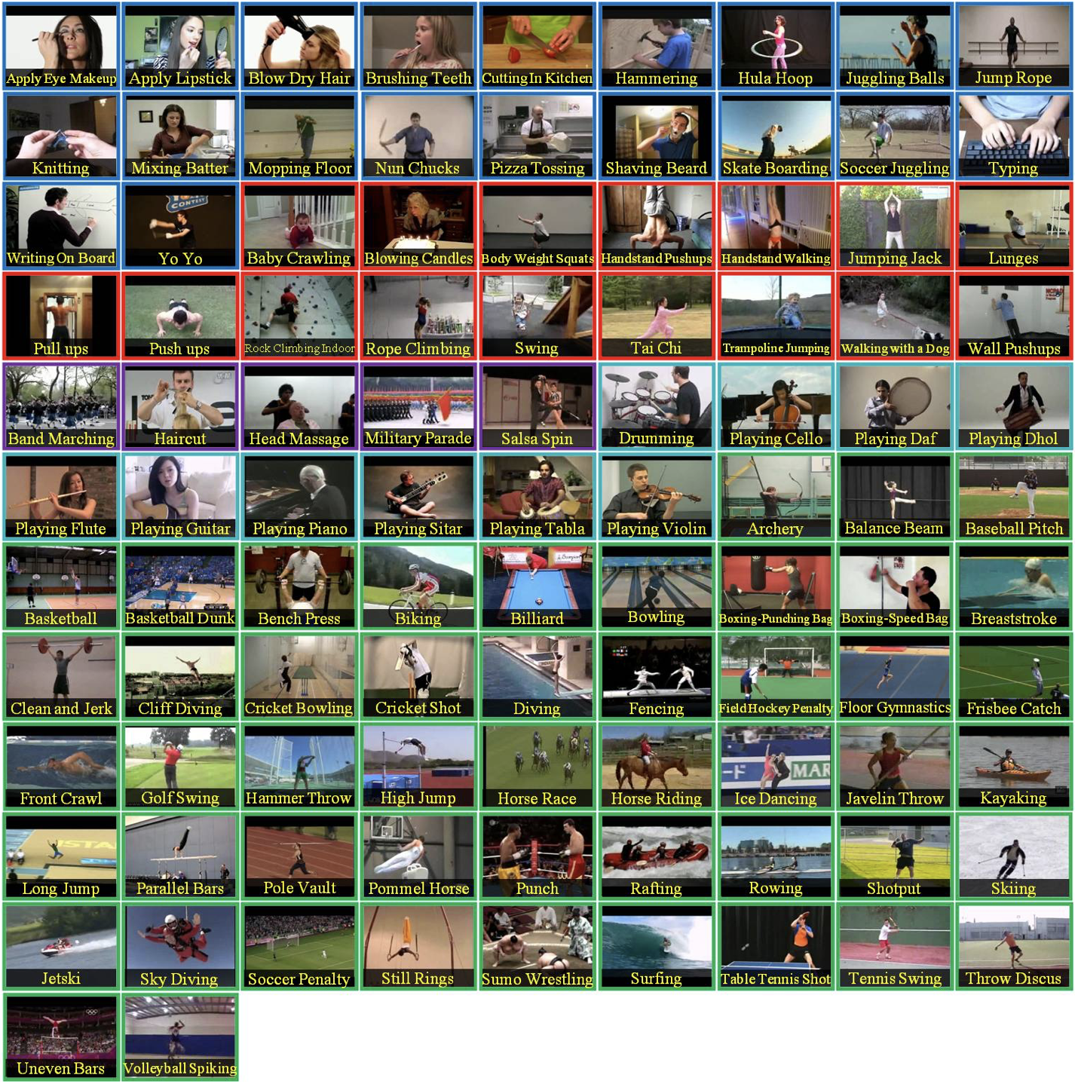
FULL DATA SET 101- different actions
WE USED
Applying eye makeup
Applying lipstick
Baby crawling
Archery
Balancing beam

Slide 5

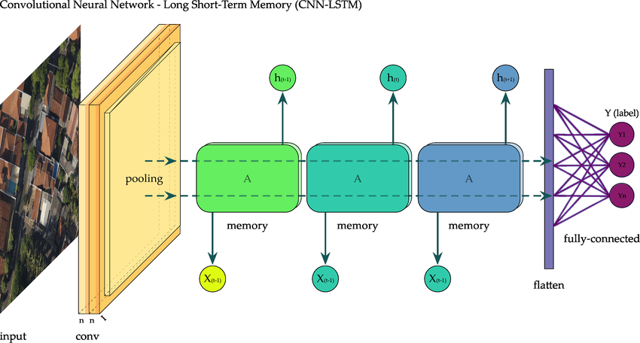
Model Architecture
CNN Backbone: ResNet‑18 (pretrained on ImageNet
Temporal Layer: Single‐layer LSTM (hidden size 256)
Classifier: Dense layer mapping LSTM’s final state → 5 classes
[Frames] → [ResNet‑18 ➔ 512‑d features/frame] → [LSTM over 50 steps] → [FC → Softmax]

Slide 6
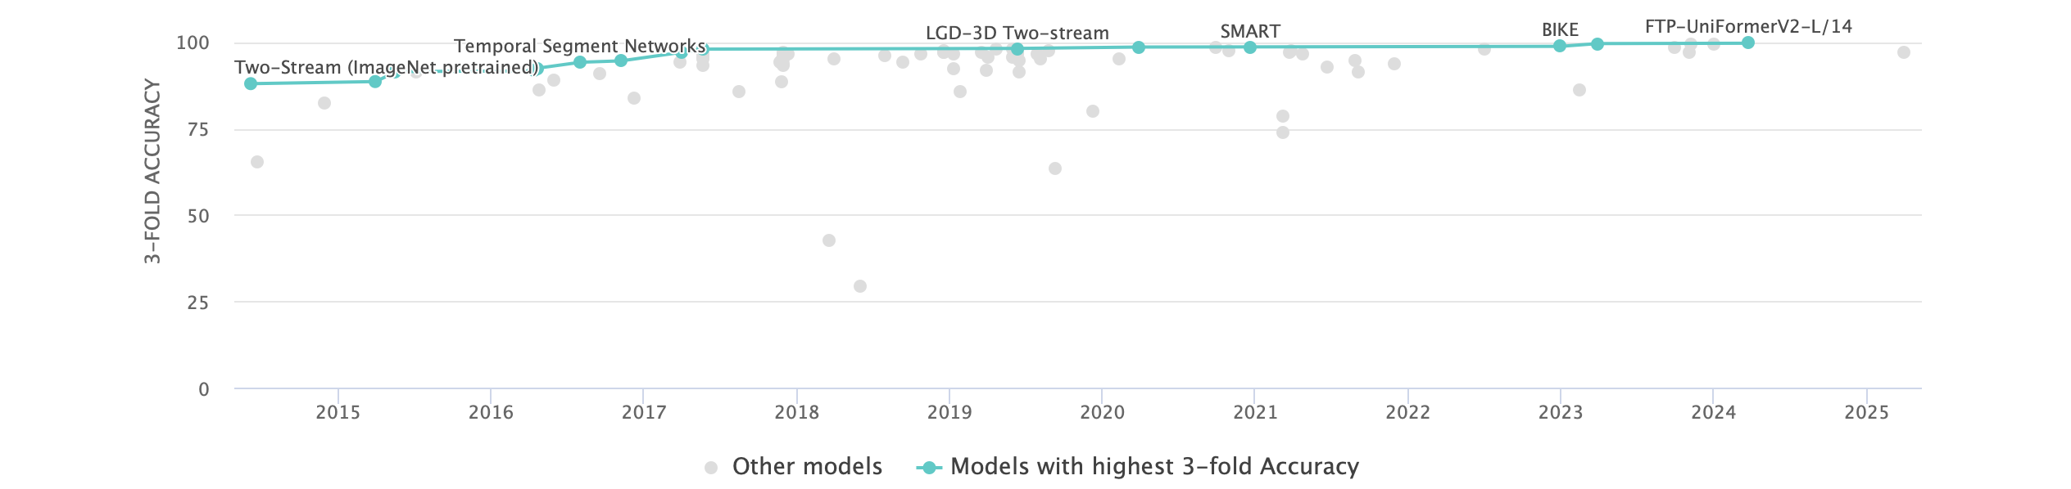
Previous Work

Slide 7
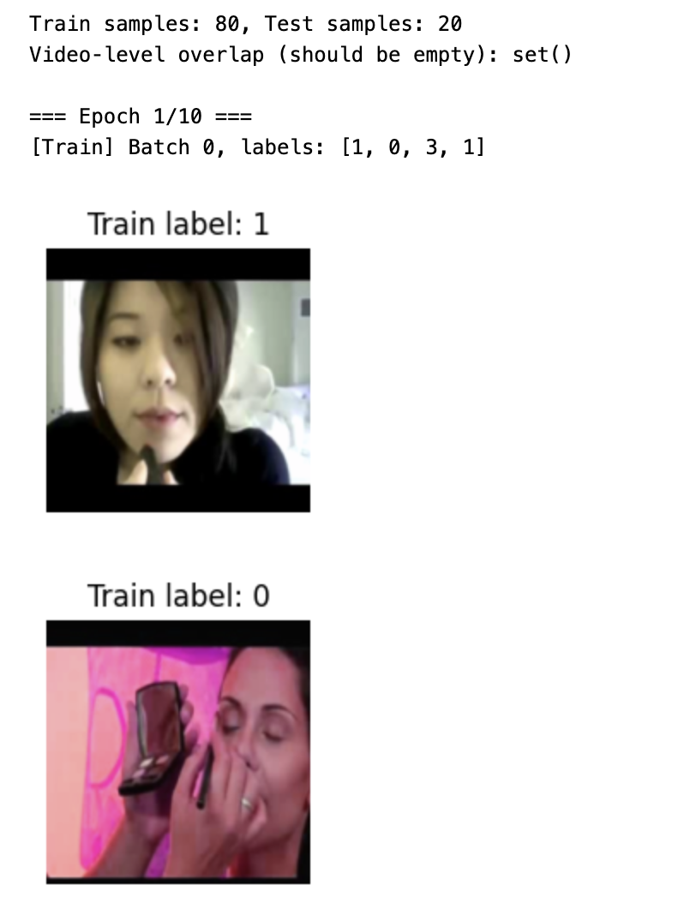
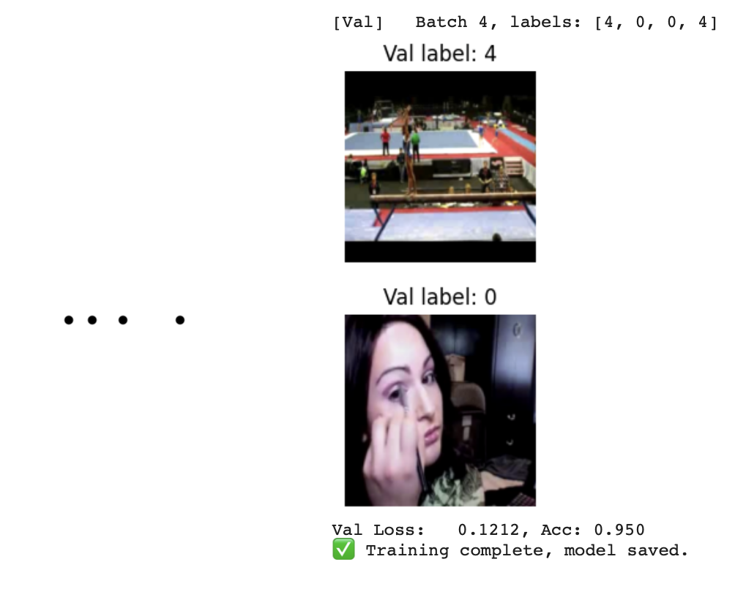
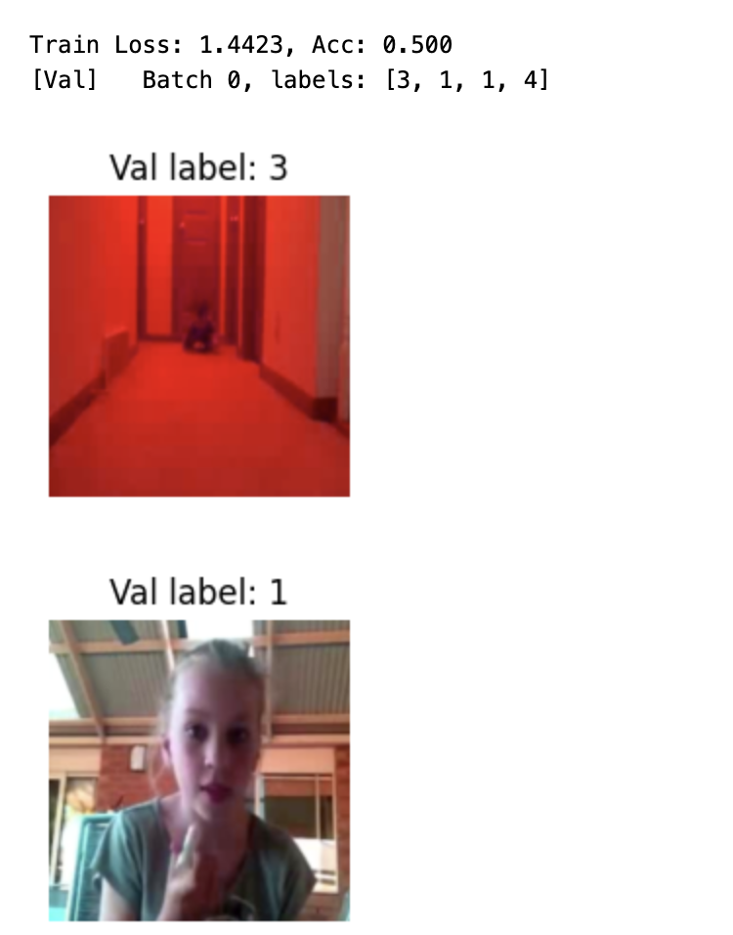
MY WORK

Slide 8
Lessons Learned & Challenges
Overfitting: Learned to check train/test leakage
Frame sampling: Switched to random sampling to avoid static cues
I/O bottleneck: Pre‑tarred frames for fast loading in Colab
Future work:
Scale to all 101 classes
Add attention or 3D CNNs
Cross‐validation

Slide 9
Conclusion
Summary: Built a working CNN + LSTM action recognizer
Key takeaway: Temporal modeling is essential for video tasks
Next: Expand dataset, refine architecture, add robust evaluation

Slide 10

THE CODE
https://colab.research.google.com/drive/1npRprZsHhnrA38QX1mjOHQtmrUr_6cwq?usp=sharing

Slide 11


